Slide 1
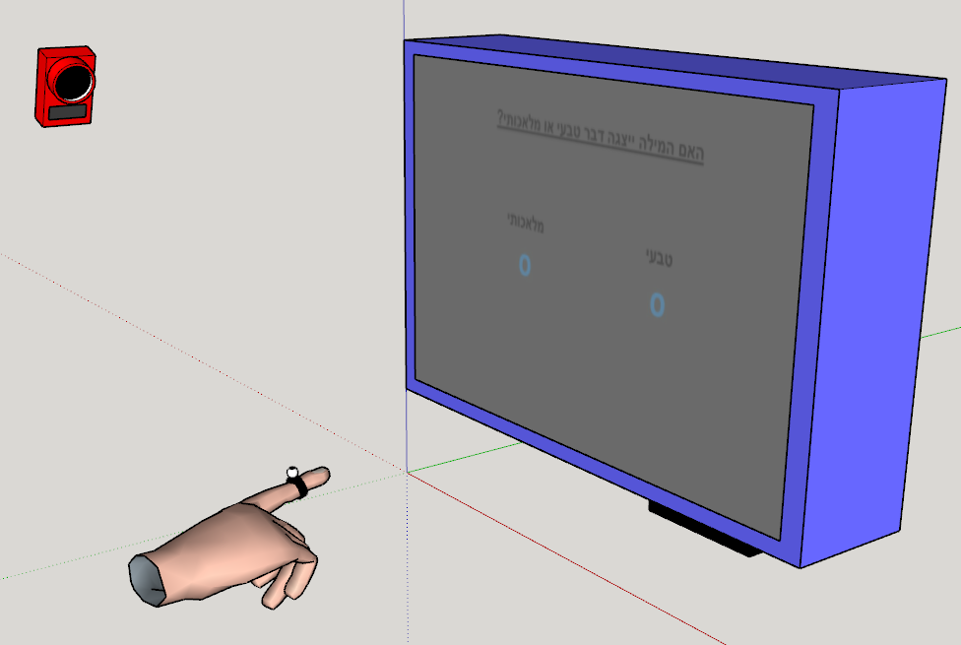
Congruent
Screen
Screen
Incongruent
Trial 1
Z index
Trial 3
Trial 2
Z index
Trial 4
Z index
Time3
same
diff
Time2
Time1
X pos
X pos
X pos
Screen
Y
Y
Y
Curve 2
Curve 1
Curve 2
Curve 1
Curve 2
Curve 1
Z
A
Screen
Screen
Screen
B
C
D
Congruent
Incongruent
h_line
h_line
h_line
X
X
X
X

Slide 2

Correct Incorreect
Is it possible that A is closer to the screen than B?
Correct Incorreect
Screen
Screen
A B
A B
Correct Incorreect
Screen
Z index
A B
Z index
Z index
X pos
X pos
Correct Incorreect
Correct Incorreect
Screen
X pos
Screen
A B
A B
Z index
Z index
X pos
X pos

Slide 3


Screen
Screen
A B
A B
Screen
- AUC
Proportion
Of Z traveled
Proportion
Of Z traveled
Proportion
Of Z traveled
+ AUC
+ AUC
Euclidean distances
Trajectory samples
Optimal path
Actual path
Optimal path
Actual path
X
X
X
Screen
Screen
Screen
Reach Area
Proportion
Of Z traveled
Proportion
Of Z traveled
MAD
Proportion
Of Z traveled
3
Deviation from center
Average Left
Average right
2
Optimal path
Actual path
1
X
X
X

Slide 4


Screen
$$θ$$
Proportion
Of Z traveled
$θ$ – Heading angle
X
Screen
Screen
Screen
Reach Area
Proportion
Of Z traveled
Right Path Area
Right Path Area
Left Path Area
Average Path Right
Average Path Left
Lowest X value
Lowest X value

Slide 5
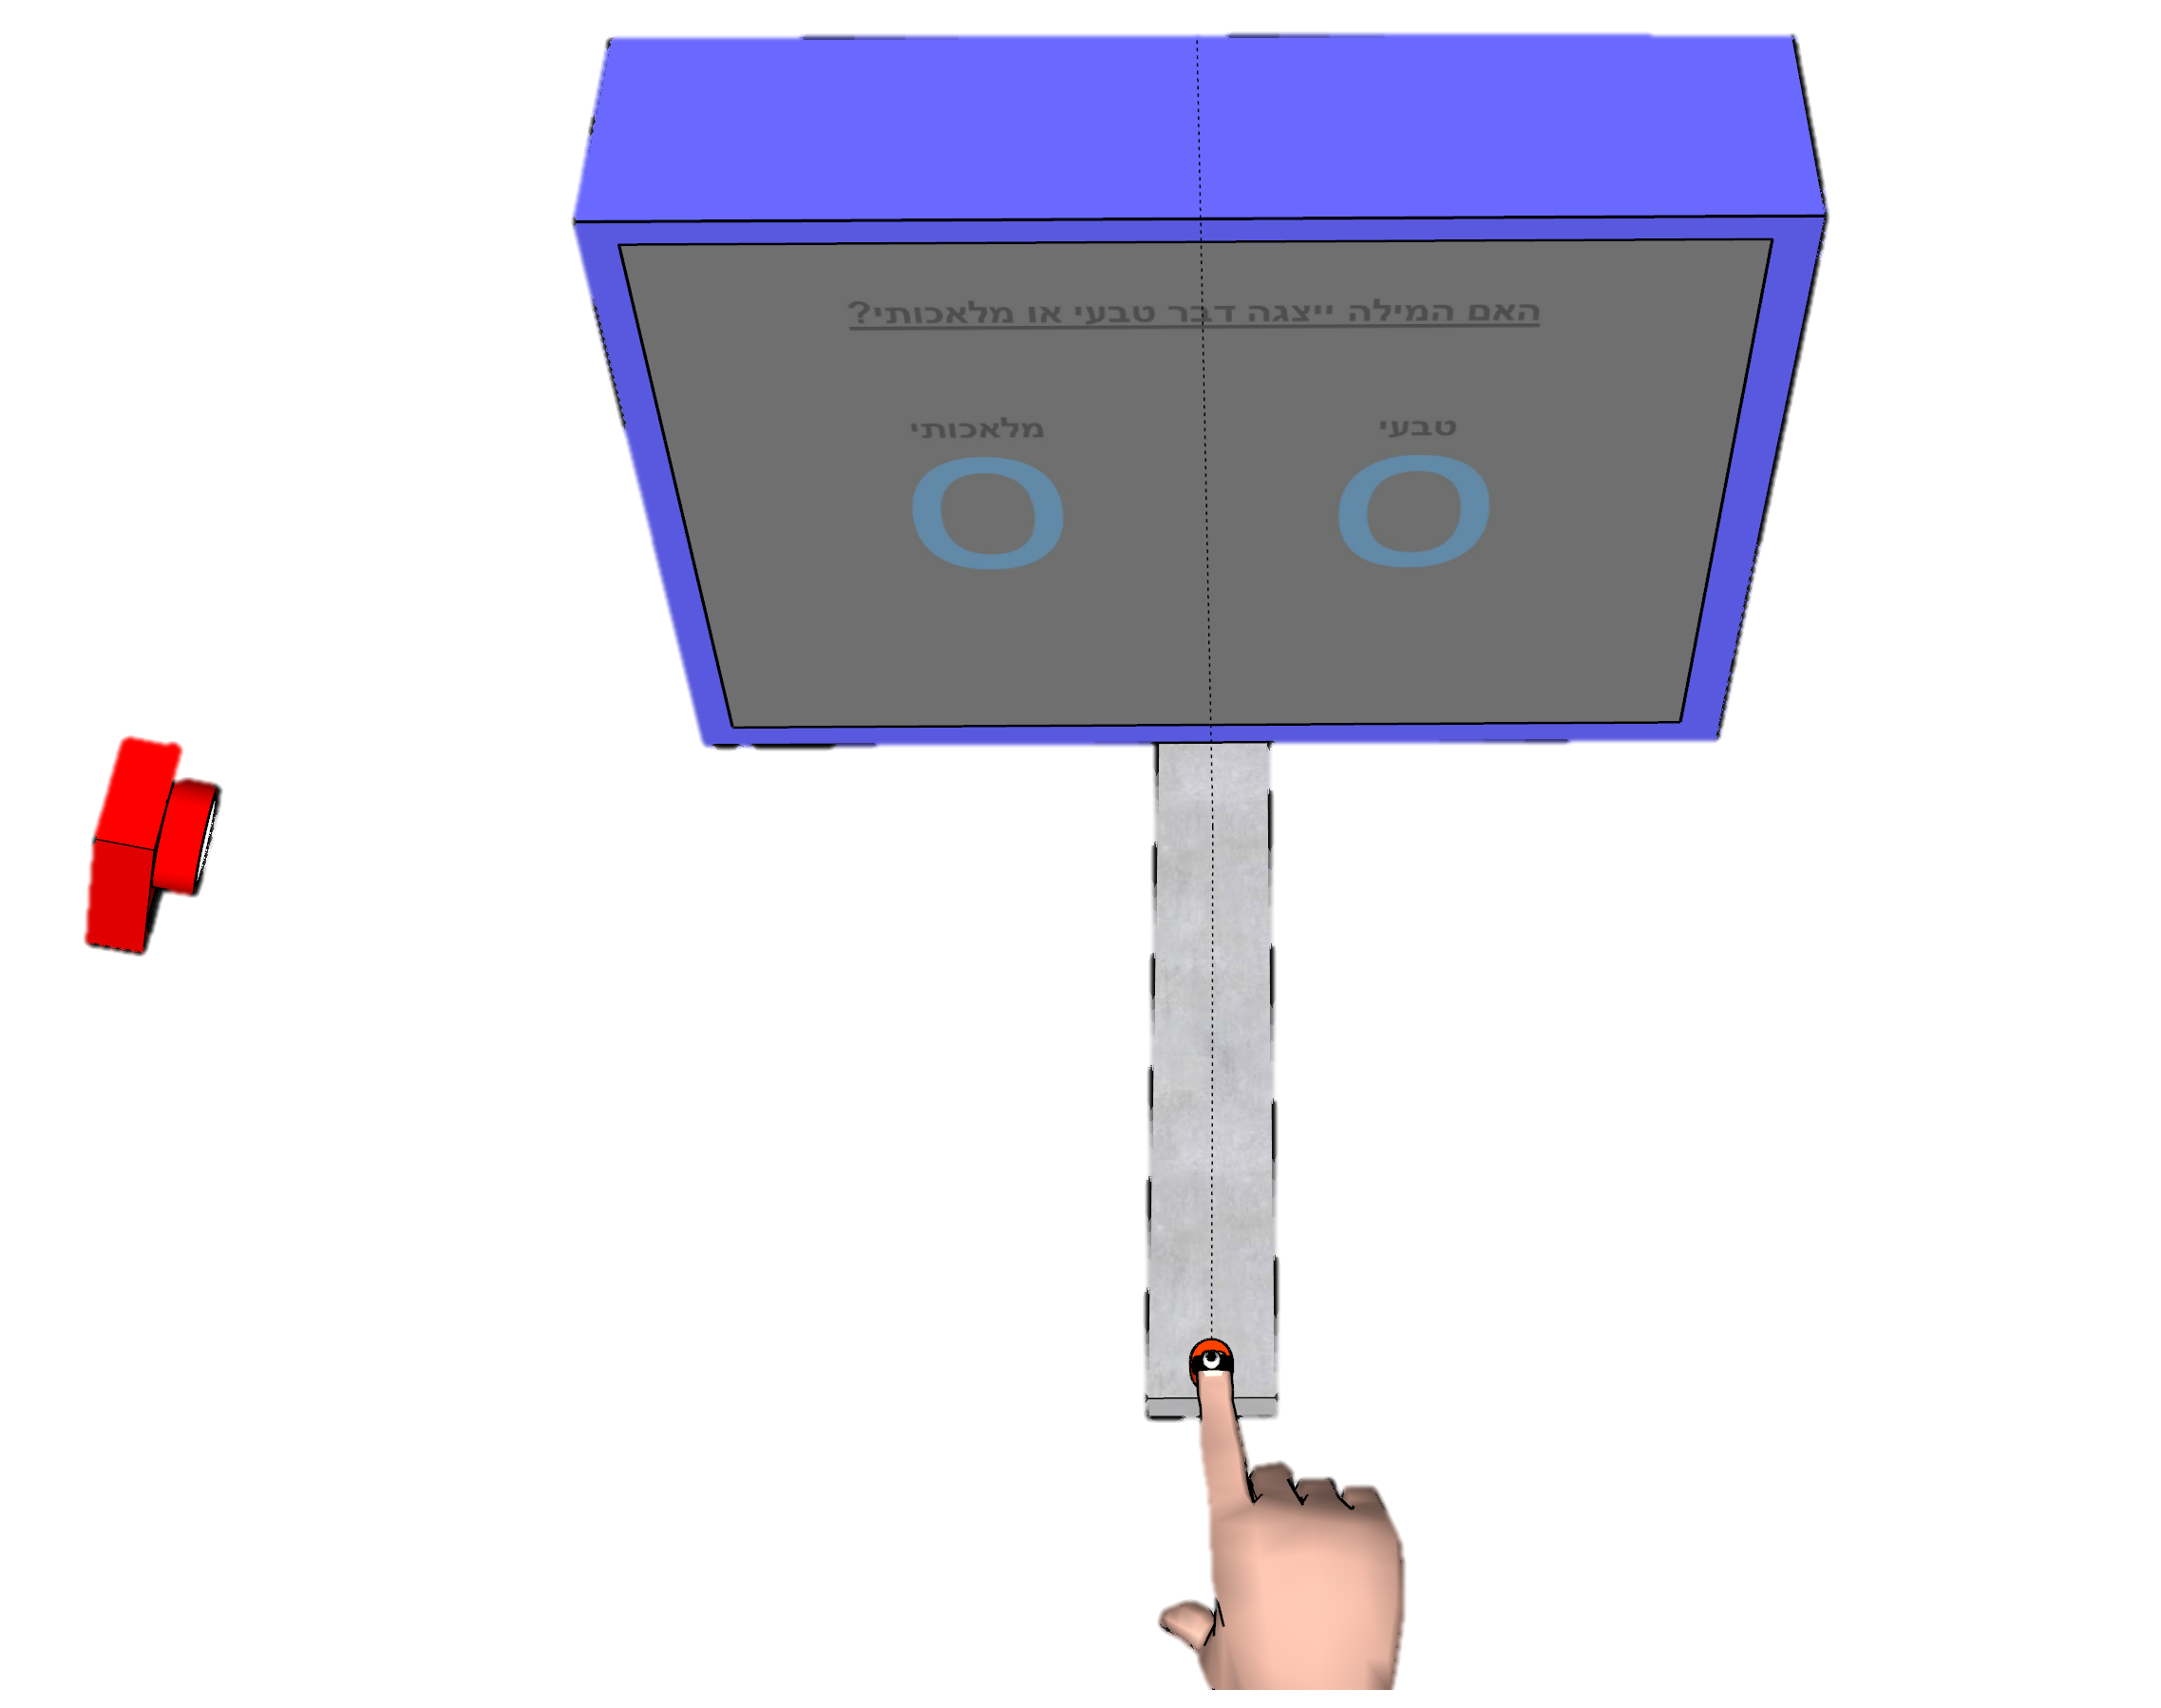
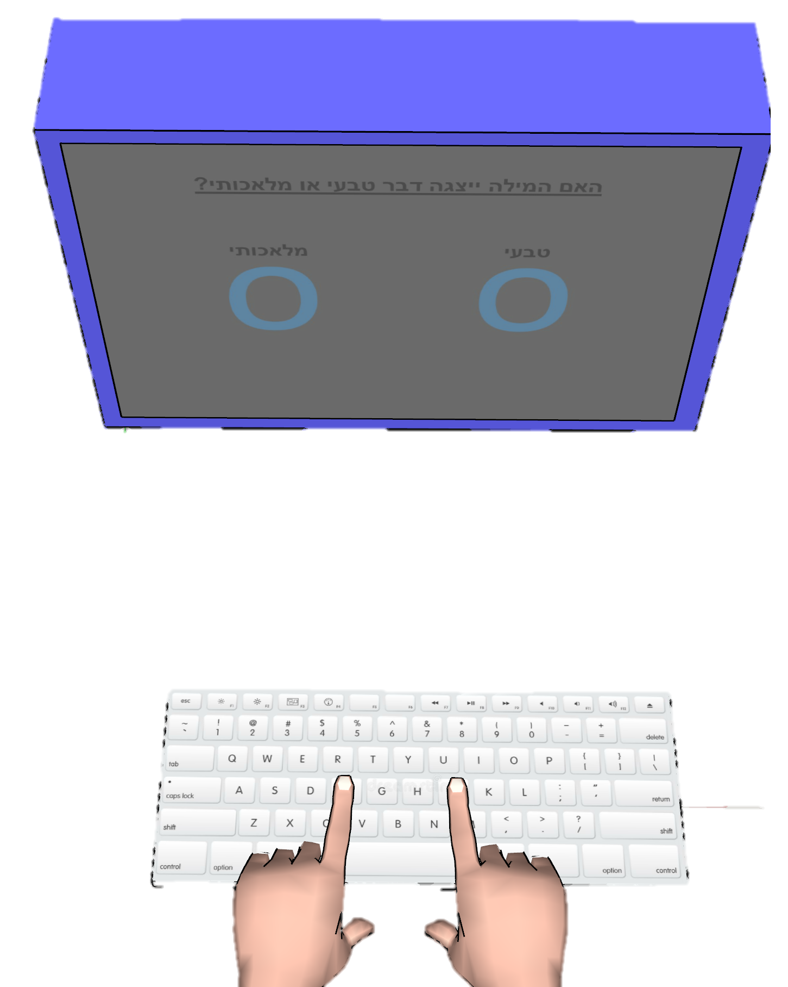
Artificial
Natural
Radio
24cm
10cm
Y
Z
35cm
X

Slide 6
Artificial
Natural
Radio
Y
Z
Max. Reach area
0.07m²
X

Slide 7



Logic for normalizing on Z
Mvmnt time changes between trials.
Let’s say I have two trials with identical X values (A), but the red trial lasts a bit longer because the sub advances slower on Z (B).
If I normalize them in time, it will seem like a diff in x-deviation exists (C), while it really doesn’t.
(A)
(B)
Screen
(C)
A B
Normalized in time
Time
Z
%Time
X pos
X pos
X pos
Since Z is constant between trials, if we normalize to it, the traj stays pretty much the same, it doesn’t “shrink” like the blue traj did. That is why a spurious effect wont appear.
Notice that normalizing means taking an equal number of points along the normalized dimension. When the dimension isn’t constant (such as time) this translate to a “shrinking” of some of the trials (as the blue trial).

